Slide 1
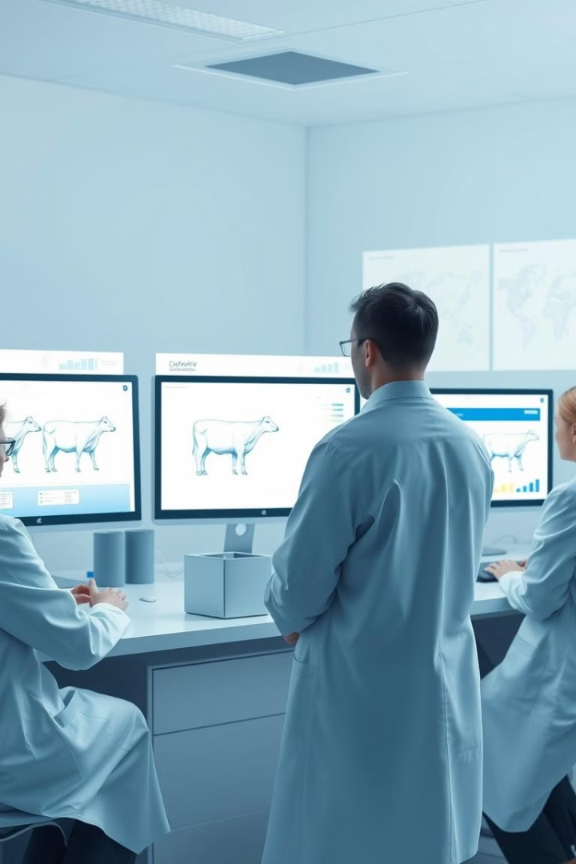
Comparing Support Vector Machines and Random Forest for Livestock Performance Prediction
By:
Sai Kiran {192225083}
Ghouse{192225035}

Slide 2
WHAT IS LIVESTOCK FARMING ??
Livestock farming is the practice of raising animals primarily for food, fiber, and other products, which vary based on regional demand, resources, and climate. Common livestock animals include cattle, sheep, goats, pigs, and poultry, although specific types may be more or less viable depending on factors like land availability, water resources, and economic support.
Livestock performance prediction involves using data and analytical methods to forecast various performance metrics of livestock, such as growth rates, milk production, reproductive success, feed efficiency, and overall health. Accurate predictions can help farmers and livestock producers make informed decisions regarding breeding, feeding, management practices, and resource allocation, ultimately leading to improved productivity and profitability.

Slide 3

The Importance of Accurate Livestock Performance Prediction
1
Optimized Resource Allocation
2
Improved Profitability
Accurate predictions lead to higher yields and reduced costs, boosting the farm's bottom line.
Precise performance forecasting enables farmers to better allocate feed, veterinary care, and other resources.
3
Enhanced Animal Welfare
Tailored care based on performance data can improve the health and well-being of livestock.

Slide 4
Algorithms for Livestock Performance Prediction
Support Vector Machines (SVM)
Random Forest (RF)
Key Differences
RF is an ensemble learning method that combines multiple decision trees to improve accuracy and robustness.
SVM focuses on finding the optimal hyperplane, while RF leverages the collective power of multiple models.
SVM is a powerful supervised learning algorithm that can handle complex, non-linear relationships in data.

Slide 5

Methodology: Applying SVM and RF to Livestock Data
1
Data Collection
Gathered comprehensive livestock performance records, including factors like weight, feed intake, and health indicators.
2
Model Training
Trained SVM and RF models using the dataset, tuning hyperparameters to optimize predictive accuracy.
3
Model Evaluation
Assessed the predictive performance of SVM and RF on a hold-out test set using relevant metrics.

Slide 6
Results: Comparative Predictive Accuracy
Support Vector Machines
Random Forest
Comparative Performance
SVM exhibited strong predictive power, particularly in capturing non-linear relationships in the data.
RF demonstrated high accuracy and robustness, leveraging the collective strength of multiple decision trees.
The results highlight the strengths of both algorithms, with each showing advantages in different scenarios.

Slide 7

Discussion: Strengths and Weaknesses
SVM Strengths
SVM Limitations
Effective in handling non-linear relationships and identifying optimal hyperplanes for prediction.
Can be sensitive to outliers and may require extensive hyperparameter tuning.
RF Strengths
RF Limitations
Robust to noise, outliers, and missing data, with the ability to capture complex patterns.
Harder to interpret the internal decision-making process compared to individual decision trees.

Slide 8
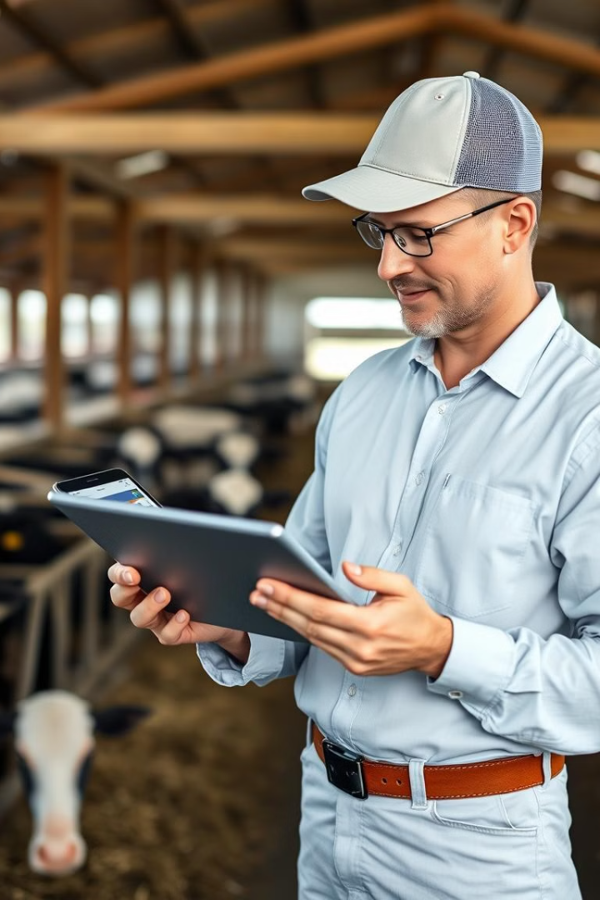



Implications for Livestock Management
Optimized Feeding
Accurate predictions can guide farmers in tailoring feed quantities and compositions.
Targeted Healthcare
Forecasting can identify animals at risk, enabling proactive veterinary interventions.
Improved Profitability
Enhanced decision-making leads to higher yields and reduced operational costs.

Slide 9




Conclusion and Future Directions
Insights Gained
This study highlights the potential of SVM and RF in livestock performance forecasting.
Ongoing Refinement
Exploring hybrid models and incorporating additional data sources can further improve predictions.
Future Research
Expanding the scope to include other livestock species and investigating real-time applications.

